Slide 1
An Inquiry into the Cross-States Impacts of Gun-Control Legislations following the 2018 Parkland High School Shooting
Arthur Langlois,
Northeastern University

Slide 2
An Inquiry into the Cross-States Impacts of Gun-Control Legislations following the 2018 Parkland High School Shooting
About the Data
- CDC’s WONDER “Underlying Cause of Death” database
Panel Data: 20 years of data (1999-2020) at the state level
Variables: Ethnicity, Injury Intent, Absolute Deaths Levels, Crude Death Rate
Strengths:
Granularity → Heterogenous Treatment Effects (ethnicity and injury intent)
19 Years of data for Pre-Treatment Period = stronger inference, more robust synthetic controls
Injury Intent specificities
Weaknesses
Only 2 years of data for Post-Treatment Period
Single ethnicity
Crude Death Rate as a share of population (per 100,000) instead of share of deaths.
Other variables (income bracket, employment…etc)

Slide 3
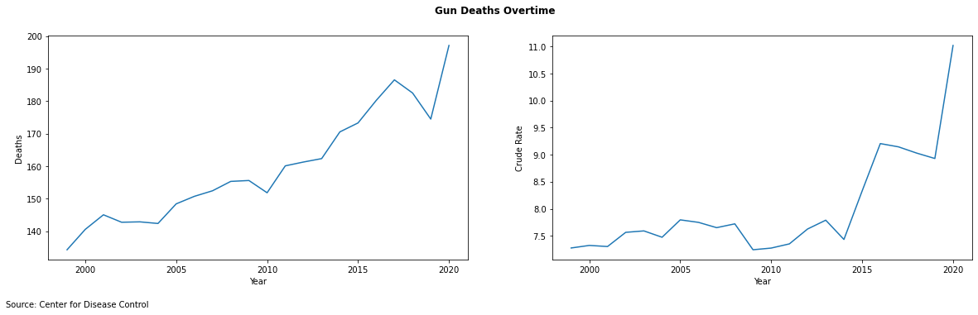
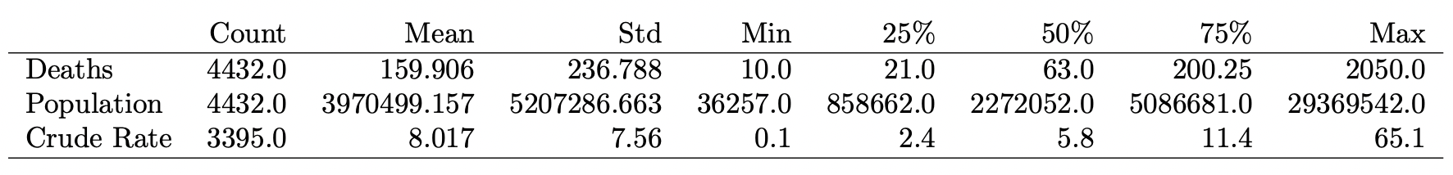
An Inquiry into the Cross-States Impacts of Gun-Control Legislations following the 2018 Parkland High School Shooting
Gun Deaths Overtime
Interesting difference between absolute number of deaths and crude rate
Drastic increase since 2014
Descriptive Statistics: Absolute Deaths, Crude Death Rate, and Population

Slide 4
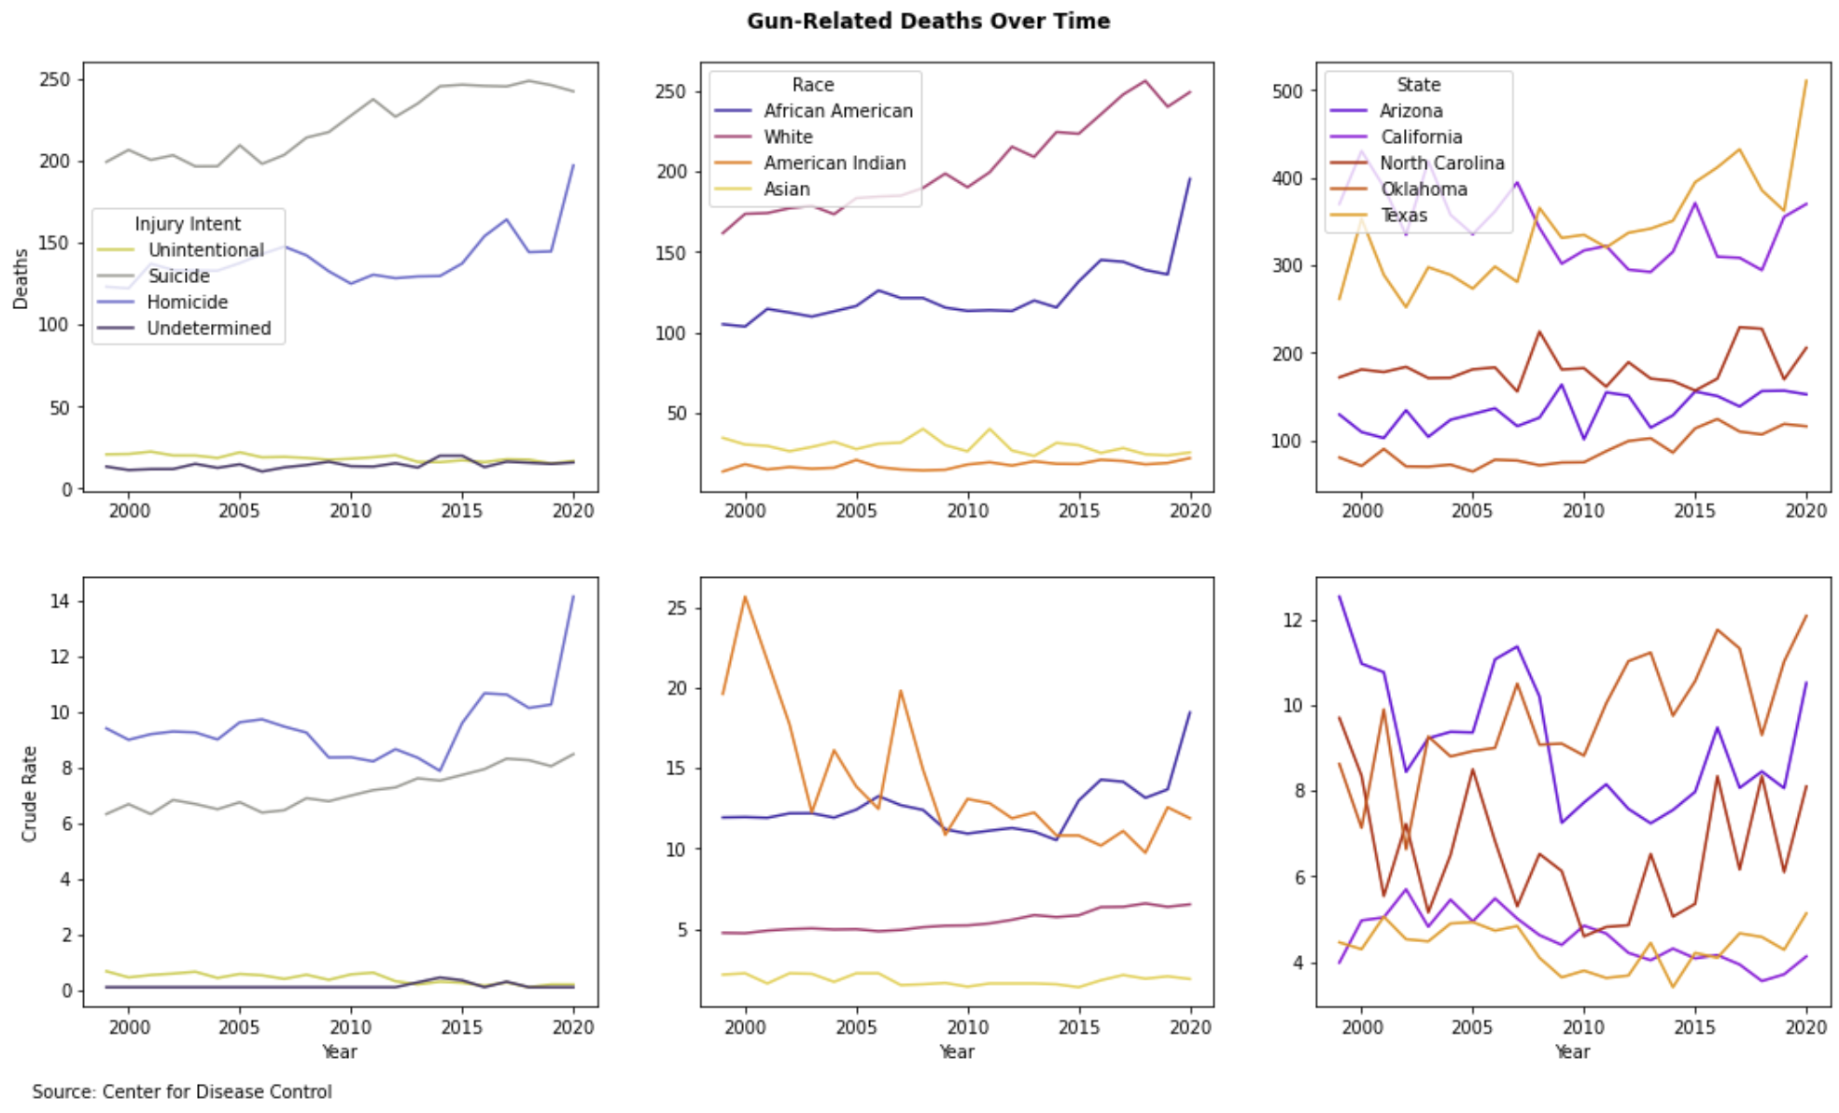
An Inquiry into the Cross-States Impacts of Gun-Control Legislations following the 2018 Parkland High School Shooting
Gun Deaths Over Time Across Race, Intent, and State
In majority driven by suicide/homicide
Overwhelming representation of African Americans and Whites
Fairly stable yet disparate levels across states

Slide 5
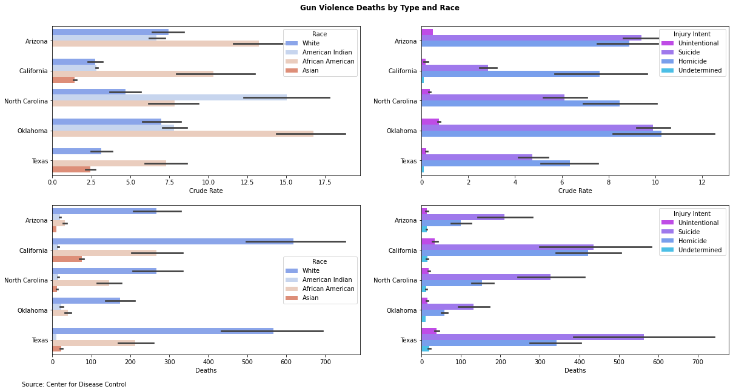
An Inquiry into the Cross-States Impacts of Gun-Control Legislations following the 2018 Parkland High School Shooting
Gun Deaths Characteristics by State
High suicide/homicide rates in AZ/OK
High death rates in North Carolina (mostly driven by American Indians)

Slide 6
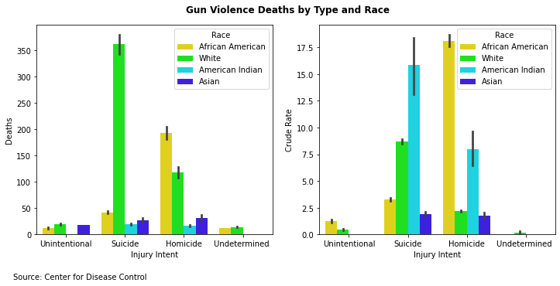
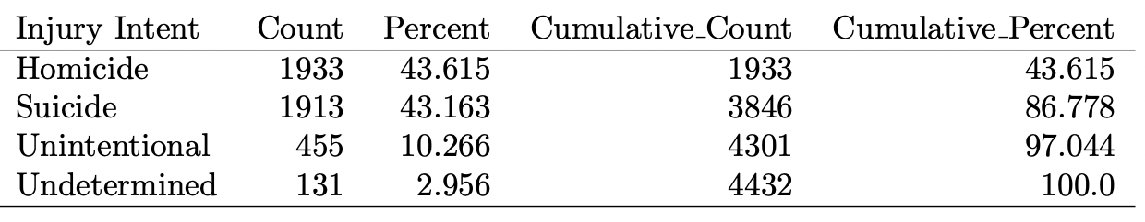
An Inquiry into the Cross-States Impacts of Gun-Control Legislations following the 2018 Parkland High School Shooting
Project Justification
Heavily imbalanced
Overwhelming representation of African Americans in homicides
Very important share of suicides for American Indians
Descriptive Statistics: Injury Intent
Notes:
ECONOMIC LOSS: $3.5 billion of medical costs alone, and an estimated 214.2 billion loss in “intangible loss of victims and survivors due to either a life cut short or a person permanently disabled by gun violence”).

Slide 7
An Inquiry into the Cross-States Impacts of Gun-Control Legislations following the 2018 Parkland High School Shooting
Conclusion
The compiled dataset provides many insights regarding the evolution of gun-related deaths across 50 states for the past two decades. The granularity of the observations, as well as the details about ethnicity and injury intents, will allow us to draw meaningful and important insights about the causal effect of the various gun-control policies that have been implemented following the Parkland High School Shooting in 2018.
Next steps:
Increase temporal granularity (get monthly level data)
Increase spatial granularity (get county data = urbanization index as a potential driver of gun-violence)
Gather average household income data by ethnicity, geographical location

